Slide 1
SB3F1 Analysis Batch 2 (GE0529)
20210827

Slide 2
General Workflow
Read Alignment by STAR
FASTQ files
FASTQ file QC
Novel Splice junction detection by Diff_Splice
transcript modeling by Kallisto

Slide 3
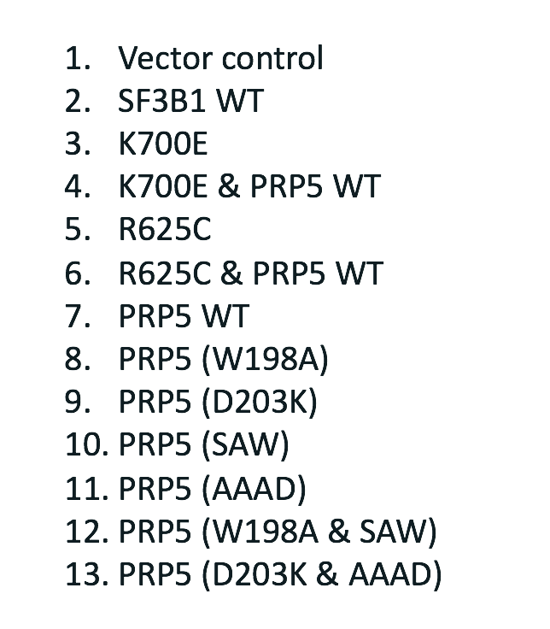
Overall Alignment and transcript quantifications are consistent across all samples with small decrease observed in K700E

Slide 4
Clustering results based on known transcript expressions
PRP5
SF3B1+PRP5
SF3B1
Vector
General observations from unbiased clustering analysis:
PRP5 overexpressed samples generally separated out from SF3B1 overexpressed samples
Vector, SF3B1 WT, SF3B1 mutants results in more consistent transcriptomic patterns compare to any samples that contains PRP5 over expression, including PRP5 WT samples.

Slide 5
Initial Differential Splice Variant Comparisons
Comparisons | Differential Splice Junctions
SF3B1 WT vs K770E | 28
SF3B1 WT vs K770E + PRP5 WT | 405
SF3B1 WT vs R625C | 53
SF3B1 WT vs R625C + PRP5 WT | 208
PRP5_WT vs AAAD | 14
PRP5_WT vs D203K | 8
PRP5_WT vs D203K + AAAD | 3
PRP5_WT vs SAW | 13
PRP5_WT vs W198A | 2
PRP5_WT vs W198A + SAW | 11
Differentially expressed junctions counts using DiffSplice built-in significant and logFC thresholds
Elevated numbers of differential jns in SF3B1 mutants combined with PRP5 WT
Small differences between SF3B1 WT vs K770E and vs. R625C, even smaller between PRP5 WT vs its mutants
More detailed examination of the data set is still needed

Slide 6
Next Steps
A potential hypothesis from this data is that elevated PRP5 WT expression results in highest level of splicing events and overwhelms any recovery that it may have on SF3B1 mutants.
Needs to perform analysis for the followings:
PRP5 and SF3B1 expressions
Compare all conditions against vector as background
Compare PRP5 WT versus SF3B1 WT

